Slide 1


“Getting to know CVC” presentation
Notes:
1

Slide 2
Getting to know CVC
On the agenda:
The role of the Form Tutor and Form Time
Expectations
Uniform
iPads for learning
Homework & Monitoring Progress
Attendance to school and logging absence
Mobile devices
Progress report

Slide 3
The Tutor’s Role
Pastoral role
Monitoring learning
Morning registration
Focus in Form Time
Weekly Assembly (Dining Hall)
Notes:
Check staff handbook for more info: emphasise that you will develop a strong relationship with tutees over the 5yrs. School’s philosophy is that this significantly helps you celebrate and support students + be a point of contact if they are struggling
3

Slide 4
Year 7 Pastoral Programme
Day | Activity
Monday | Assembly
Tuesday | Notices, RRSA, Eco-focus
Wednesday | Active Form Time/ Tutor 1-2-1 check in Week A- COMBI Week B- ERTNV
Thursday | Improving Reading skills
Friday | Improving oracy Tutor 1-2-1 check in
Notes:
Form time is structured. It set students up for the day and is structured. Provides opportunities for tutees to work together, develop friendships, a sense of identity + tutees become a supportive network in themselves
4

Slide 5
Behaviour expectations
The code of conduct can be found on the school’s website https://www.combertonvc.org/parent-and-student-information/code-of-conduct
We have high expectations of behaviour and conduct
Confident, Capable and Caring
Notes:
Check staff handbook for more info.
5

Slide 6
Bus expectations
We expect the school code of conduct to apply on buses too where pupils should remain seated with a calm atmosphere.
Pupils need to bring their bus pass with them daily, there is a bus sanction ladder for those pupils who regularly forget it.
If a bus pass gets lost pupils can get a temporary pass from the office while they wait for a new one.
Notes:
Check staff handbook for more info, the sanction ladder takes them through levels of detentions
6

Slide 7
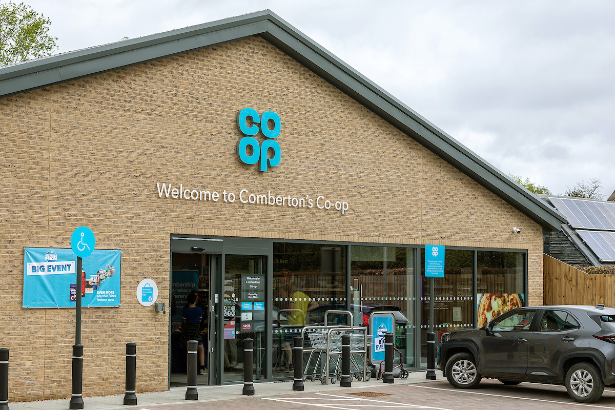
Comberton VC and Co-op Partnership
For safeguarding reasons, Pupils are not permitted to go into co-op between 8am and 3pm
Pupils accessing the shop, in uniform, outside of those times are expected to adhere to the school code of conduct
Where conduct is a concern we have agreed to work with coop to identify pupils and follow up
Notes:
Parents should be made aware that with the proximity of co-op we have to work in partnership, so we will support co-op in using CCTV where necessary to identify problems and this may result in escalation to the police if needed.
7

Slide 8
Uniform
It’s a big school – please name all clothing & footwear (Lost property is by Reception)
Skirts/trousers must be the CVC embroidered ones sold by our suppliers.
Skirts must be knee length
Shoes must be plain black with no visible logo
Coats and hoodies are to be worn on top of the school sweatshirt, not in place of them.
Jewellery & makeup – refer to Policy and guidance on this https://www.combertonvc.org/parent-and-student-information/uniform
Extreme hair styles and colours not permitted.
Notes:
8

Slide 9
iPads for Learning
Have been handed out to pupils
Teachers are beginning to use these in lessons across the curriculum
Any technical problems (or damage, etc), please ask your child to speak to their form tutor
  If needed, they will be directed to the IT Support team
  Most common problem is pupils forgetting their passcode: if typed in incorrectly too many times, IT Support must unlock
If you have joined the iPad scheme, your child will be able to connect their iPad to your home Wi-Fi network
Please see https://www.combertonvc.org/parent-and-student-information/e-safety.php for more information on how to keep you child safe online.
Notes:
9

Slide 10
Bromcom
Bromcom is a website we use at CVC; it allows you to:
See what homework has been set
See when it is due
See your child’s timetable
The app for Bromcom is My Child at School
Go4Schools
Later in the year we will also introduce you to Go4Schools which is where we record pupil progress.
Notes:
10

Slide 11
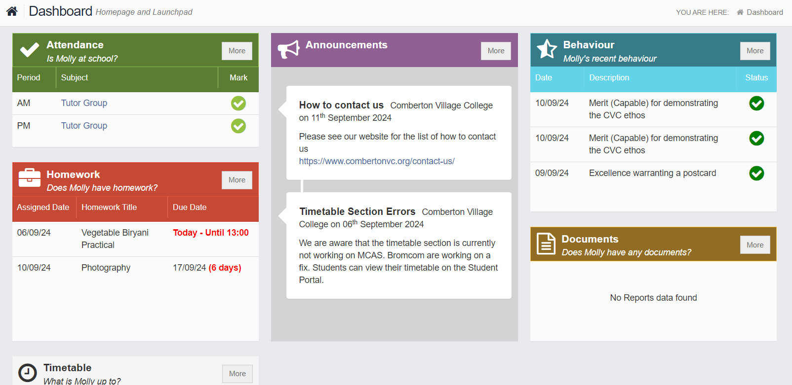
My Child At School App
Timetables will appear here but at the moment please use the one that the data team have emailed to you.
Notes:
My child at school is the app run by Bromcom. When you sign up to My Child At School (MCAS) this is what you can see. Please draw attention to the behaviour section and explain that pupils can get merits for small positive acts and postcards for bigger ones. You will also see detentions in this section.
Homework is explained in more detail on the next slide.

Slide 12
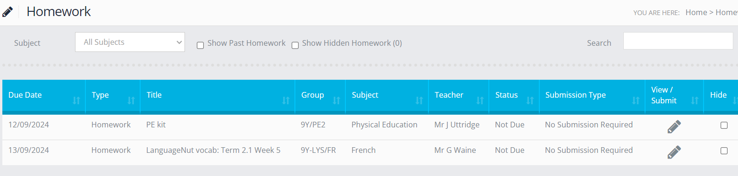
Homework on Bromcom
We do not use Bromcom to record pupils’ progress, so you will regularly see that homework says ‘no submission required’
The homework still needs to be given to the teacher! It just means the teacher won’t be submitting the marks into Bromcom.
Notes:
This is the pupil view of homework, they should click ‘hide’ when they’ve finished a homework. Be aware that if they click hide it will also be hidden from your MCAS.

Slide 13
Homework Routine
When will your child do his/her homework?
Provide an appropriate work environment
Most important to start early & have a regular routine
Encourage your child to complete homework on the night it is set if possible
Pack school bag the night before
Is it Week A or B??
Notes:
13

Slide 14
Praise and Rewards
On Bromcom you will also find a record of your child’s…
Merits
Postcards
Behaviour concerns – detentions set for lunchtime or afterschool
Notes:
Merits can be given to students in years 7-11 for a range of reasons, including: classwork completed to a high standard; homework completed to a high standard; excellent effort; or a contribution to the school community.
Postcards are highest level of reward given to students. Students (and parents) receive an electronic postcard containing a short message from the member of staff. They could be sent to students for: a truly exceptional piece of work; excellent work over a sustained period; excellent achievement in an assessment; or excellent effort over a sustained period.
Where pupils don’t meet the college’s expectations, we may take steps to help students meet those expectations. These include warnings and lunch/afterschool detentions, which parents are notified of on the day they are received. Members of staff will contact parents directly if there are more serious concerns and these sanctions will also be visible on Bromcom.
14

Slide 15
Attendance
Your child is registered each lesson and we will contact you directly if we become concerned. Attendance to school is one of the most important success criteria in terms of achievement at school.
Punctuality is vital - please help your child to be at school on time.
Lateness to lessons - if pupils are 5 mins+ late to a lesson, they will be marked as ‘late’ and recorded on Bromcom as missing more than 10% of a lesson. Pupils will receive a written warning home on the first occasion, and then an afterschool detention for subsequent late arrival to lessons.
Significant late arrival at lessons (more than 10 mins late), will lead to a pupil receiving an after school detention.
Planned absences - should be avoided on school days but should always be requested in advance via the absence request form online or are available from the Attendance Office. COM-Attendance@combertonvc.org
Notes:
15

Slide 16
Absence
Please phone the switchboard (01223 262503) or use the absence notification on website. On each day of absence, please provide a reason.
Medical appointments need to be emailed to com-Attendance and the tutor.
If leaving the school for an appointment, pupils will need to sign out of school at the Attendance Office.
Illness - if your child is ill in school, the nurse will contact you and ask you to collect them (pupils must not contact you directly).
It is the pupil’s responsibility to catch up on missed work, and it is important that they do!
Notes:
16

Slide 17
Mobile Phones
Leave at home if possible.
Switched off during the day. If a device is seen whilst on school premises, this will be confiscated and passed onto our School Receptionist to be collected at the end of the school day.
Parents call the school switchboard if you need to pass on a message to your child.
No text or calls are allowed to be made during the school day.
It is forbidden to photograph anyone in school or on the way to/from school.
School is not liable in case of loss.
Ipads must not be used at break or lunch time
Notes:
17

Slide 18

Progress information and reports
At the start of next term we will send out communication on how to access GO4Schools.
G4S will be updated to show information about your child’s effort and attainment.
You will also receive a report with effort grades on 13th November which is designed to show how well your child has settled in. There will be a second report showing your child’s depth of understanding as well as effort in the Spring Term.
There will be a Parents’ Evening on Thursday 12th February 2026. Parents evenings are online.
Notes:
18

Slide 19

Message regularly communicated to Pupils at CVC:
CVC has a zero tolerance policy for:
racist / sexist / homophobic / ablist / transphobic behaviour and language.
Offensive language (online or in person) may include:
Words like the n-word and the f-slur.
Comments about someone’s physical appearance (e.g. skin colour).
Negative references to someone’s religion, language, ethnicity, race, sexual orientation, gender.
All of this behaviour is sanctioned in line with our safer corridors policy, and followed up in other ways, too.
We can’t do this without you!

Slide 20
Peer-related behaviours and child on child abuse
Our staff and pupils are active at calling out behaviours which are unhealthy and unacceptable.
Staff are encouraged to challenged behaviour by saying phrases such as, ‘That language is not acceptable’ and ‘That’s not funny’.
If you are contacted by a member of staff to communicate behaviour displayed by your child, or if they have played a part in peer-related behaviour, please be aware that we may use the phrase ‘child-on-child abuse’.
All instances of child on child abuse are logged so that we know how to best support a child whilst at our school in educating them of their behaviours.
Notes:
Give out log in details
20

Slide 21
Please help us ensure that everyone feels safe and happy at CVC:
To report an incident, you can:
Email Ms Burns: pburns@combertonvc.org
Tell your form tutor.
Tell your head of year.
Tell a teacher you feel comfortable with.

Slide 22
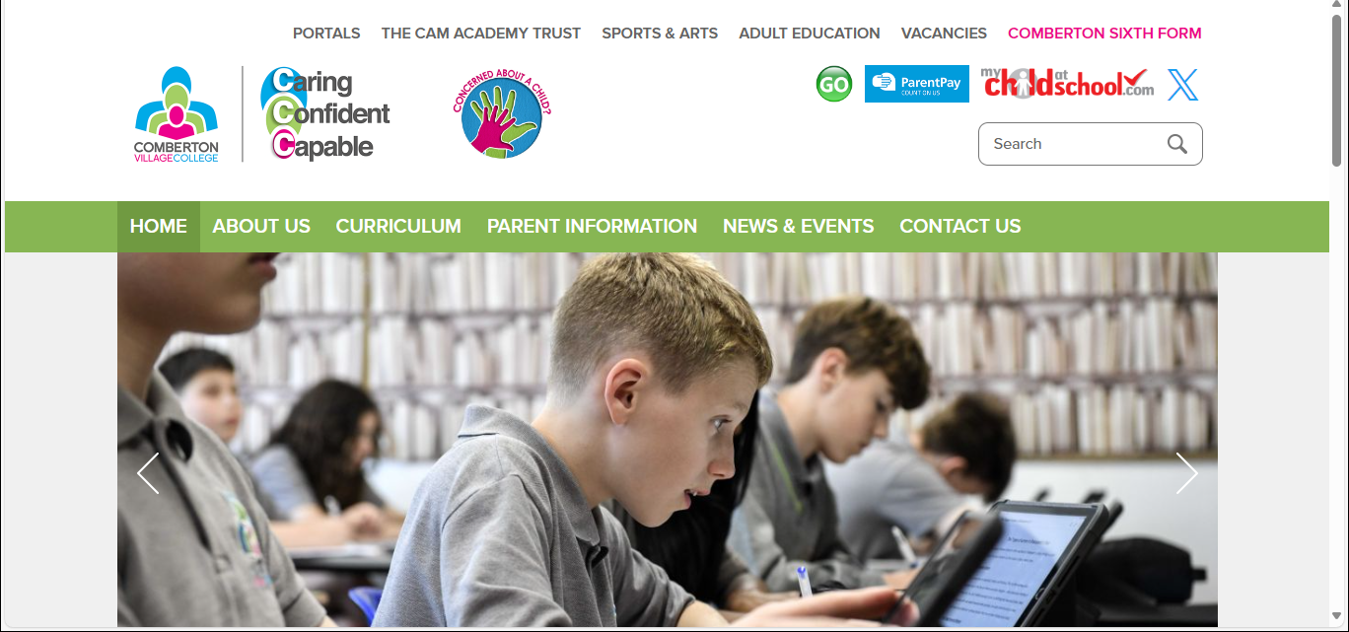
Where to go if you have concerns about your child’s wellbeing
Please see our school website where you will see this logo to press and report a concern…
Notes:
Give out log in details
22

Slide 23
Any Questions
Thank you for listening.
thecollege@combertonvc.org

